Slide 1
Chapter 10: File-System Interface

Slide 2
Three/Four Key Components of an OS
1. Process Management
2. Memory Management
3. Storage Management
3.5 I/O Systems
Notes:
《Three Easy Pieces》书中三个部分：虚拟化（Virtualization），并发（Concurrency），持久化（Persistence）

Slide 3
Outline
File Concept
Access Methods
Disk and Directory Structure
File-System Mounting
File Sharing
Protection

Slide 4
Objectives
To explain the function of file systems
To describe the interfaces to file systems
To discuss file-system design tradeoffs(讨论文件系统设计的权衡取舍), including access methods, file sharing, file locking, and directory structures
To explore file-system protection

Slide 5
10.1 File Concept(文件概念)
Contiguous logical address space 文件是连续的逻辑地址空间
Types:
Data 数据文件
numeric
character
binary
Program 程序文件
Contents defined by file’s creator
Many types
Consider text file, source file, executable file

Slide 6
File Attributes(文件属性)
Name – only information kept in human-readable form
Identifier(标识符) – unique tag (number) identifies file within file system 在有些系统中，没有显式的标识符。但可以认为文件有隐含的标识符，比如文件第一个字节所在的块号等
Type – needed for systems that support different types
Location – pointer to file location on device
Size – current file size

Slide 7
File Attributes(文件属性)
Protection – controls who can do reading, writing, executing
Time, date, and user identification – data for protection, security, and usage monitoring
有关文件的这些信息存放在磁盘中的目录结构中
Many variations, including extended file attributes such as file checksum

Slide 8
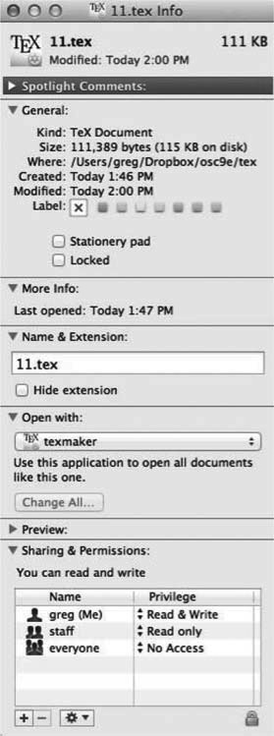
File info Window on Mac OS X

Slide 9
File Operations(文件操作)
File is an abstract data type
Create
Write – at write pointer location
Read – at read pointer location
Reposition within file - seek
Delete
Truncate(截短) OSC书上说的截为0长度只是截短的其中一种情况
Open(F_{i}) – search the directory structure on disk for entry F_{i}, and move the content of entry to memory
Close (F_{i}) – move the content of entry F_{i} in memory to directory structure on disk

Slide 10
Open Files(打开文件)
Several pieces of data are needed to manage open files:
Open-file table(打开文件表): tracks open files
File pointer(文件指针): pointer to last read/write location, per process that has the file open
File-open count(文件打开计数器): counter of number of times a file is open – to allow removal of data from open-file table when last processes closes it 一个文件可以在多个进程中共享打开
Disk location of the file(文件在磁盘的位置): cache of data access information
Access rights(访问权限): per-process access mode information
Notes:
进程打开文件列表；系统打开文件列表

Slide 11
Open File Locking(文件锁)
Provided by some operating systems and file systems
Similar to reader-writer locks 类似于读者-写者锁
Shared lock(共享锁) similar to reader lock(读者锁) – several processes can acquire concurrently
Exclusive lock(专用锁) similar to writer lock(写者锁) 互斥
Mediates access to a file(协调对文件的访问)
Mandatory or advisory:
Mandatory(强制) – access is denied depending on locks held and requested 互斥
Advisory(建议) – processes can find status of locks and decide what to do

Slide 12
Mandatory Locking(强制锁)
对于采用强制锁的文件，一个进程一旦获得锁，由OS保证其他进程就无法访问此文件(即使其他进程不调用加锁操作，直接操作文件也不行)，也就是OS保证共享文件的完整性
Linux默认是建议锁。要打开强制锁，需要进行文件系统级及单个文件的使能操作：
Mount the file system with “-o mand” option
For the lock_file, turn on the set-group-ID bit and turn off the group-execute bit, to enable mandatory locking on that particular file. (This way has been chosen because when you turn off the group-execute bit, set-group-ID has no real meaning to it )

Slide 13
Advisory Locking(建议锁)
建议锁需要参与文件共享的各个进程间合作。比如进程P1获得了文件的写者锁，P2可能：
进程P2试图获得锁，无法获得，文件完整性得到保证。这样的P2进程是合作进程
进程P2略过加锁的过程，直接读写文件，文件完整性有可能被破坏。这样的P2进程是非合作进程
进程是否合作是由软件开发人员决定的，所以这种锁称为建议的。
一般Windows采用强制锁，Linux采用建议锁
Notes:
Ref. https://www.thegeekstuff.com/2012/04/linux-file-locking-types

Slide 14
File Locking Example – Java API
import java.io.*;
import java.nio.channels.*;
public class LockingExample {
public static final boolean EXCLUSIVE = false;
public static final boolean SHARED = true;
public static void main(String arsg[]) throws IOException {
FileLock sharedLock = null;
FileLock exclusiveLock = null;
try {
RandomAccessFile raf = new RandomAccessFile("file.txt", "rw");
// get the channel for the file
FileChannel ch = raf.getChannel();
// this locks the first half of the file - exclusive
exclusiveLock = ch.lock(0, raf.length()/2, EXCLUSIVE);
/** Now modify the data . . . */
// release the lock
exclusiveLock.release();

Slide 15
File Locking Example – Java API (Cont.)
// this locks the second half of the file - shared
sharedLock = ch.lock(raf.length()/2+1, raf.length(), SHARED);
/** Now read the data . . . */
// release the lock
sharedLock.release();
} catch (java.io.IOException ioe) {
System.err.println(ioe);
} finally {
if (exclusiveLock != null)
exclusiveLock.release();
if (sharedLock != null)
sharedLock.release();
}
}
}
Notes:
红色字体的+1，是否多余？属瑕疵

Slide 16
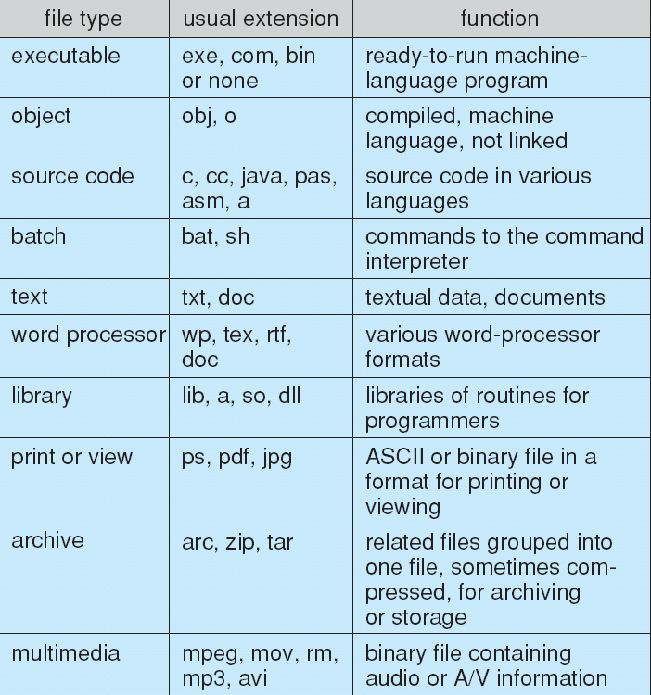
File Types – Name, Extension

Slide 17
File Structure(文件结构)
None(无结构) - sequence of words, bytes
Simple record structure(简单记录结构)
Lines
Fixed length
Variable length
Complex Structures(复杂结构)
Formatted document
Relocatable load file
Can simulate last two with first method by inserting appropriate control characters
Who decides:
Operating system
Program

Slide 18
10.2 Access Methods(访问方法)
Sequential Access(顺序访问) 处理文件的连续若干个记录
read next
write next
reset
Direct Access(直接访问，相对访问) – file is fixed length logical records 文件有固定长度的记录，可随机访问
read n
write n
position to n
read next
write next
n = relative block number

Slide 19
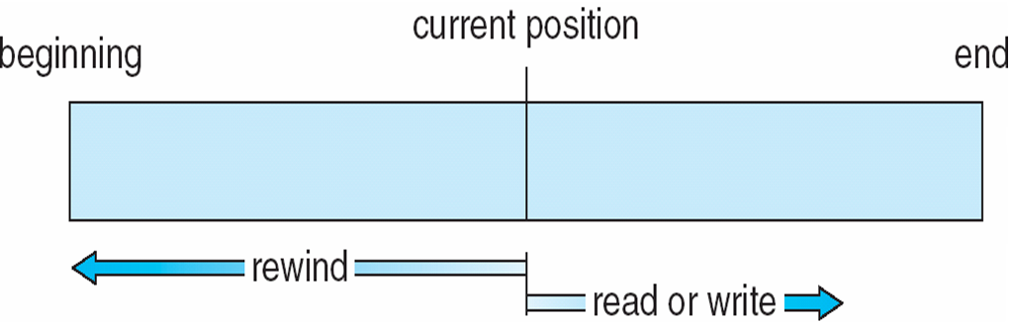
Sequential-access File(顺序访问)

Slide 20
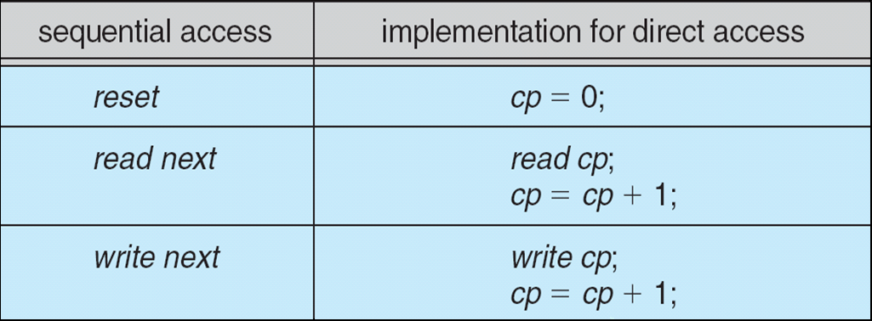
Simulation of Sequential Access on Direct-access File
在直接访问的文件上，模拟实现顺序访问

Slide 21
Other Access Methods(其他访问方式)
Can be built on top of base methods
General involve creation of an index(索引) for the file
Keep index in memory for fast determination of location of data to be operated on (consider UPC code plus record of data about that item)
If too large, index (in memory) of the index (on disk)
IBM indexed sequential-access method (ISAM，索引化顺序访问方法)
Small master index, points to disk blocks of secondary index
File kept sorted on a defined key
All done by the OS
VMS operating system provides index and relative files as another example

Slide 22
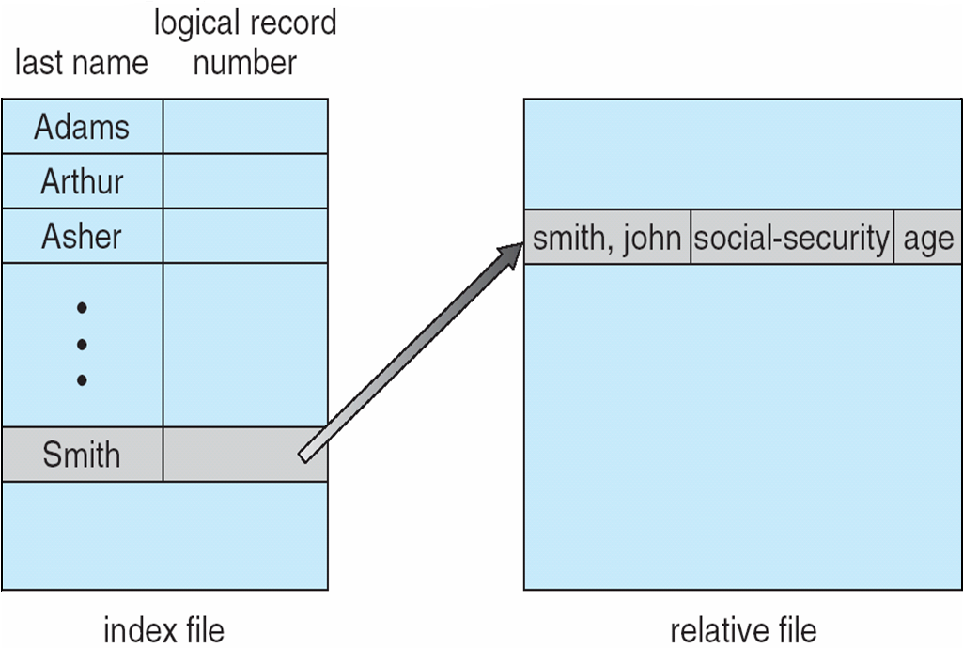
Example of Index and Relative Files

Slide 23
10.3 Directory Structure(目录结构)
目录是包含所有文件信息的一系列节点
Directory
Files
F 1
F 2
F 3
F 4
F n
目录结构与文件均存储在磁盘

Slide 24
Storage Structure(整个磁盘的存储结构)
Disk can be subdivided into partitions(磁盘可分区)
Disks or partitions can be RAID(磁盘冗余阵列，见12.7) protected against failure
Disk or partition can be used raw(生磁盘) – without a file system, or formatted(已格式化) with a file system
Partitions also known as minidisks(小型磁盘), slices
Entity containing file system known as a volume(卷)
Each volume containing file system also tracks that file system’s info in device directory or volume table of contents
As well as general-purpose file systems there are many special-purpose file systems, frequently all within the same operating system or computer

Slide 25
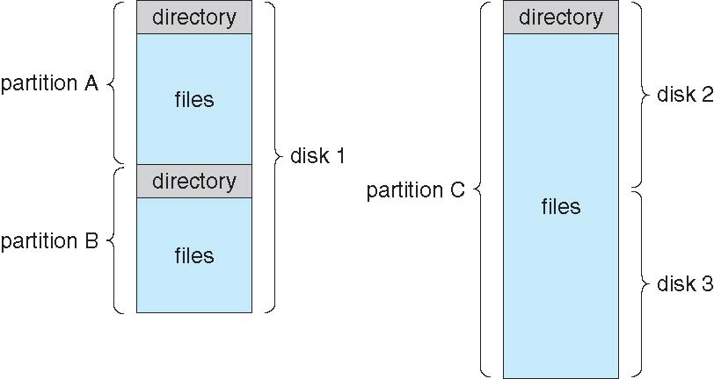
A Typical File-system Organization
一个物理磁盘，可划分为多个分区。
有的系统，允许一个分区跨越多个物理磁盘

Slide 26
Directory Overview(目录概述)
Search for a file
Create a file
Delete a file
List a directory(遍历目录)
Rename a file
Traverse the file system(遍历文件系统)
Notes:
注：OSC7中文译本把” Traverse the file system”翻译为”跟踪文件系统”，这与正文不符

Slide 27
Errata
OSC7中文译本把
Traverse the file system
翻译为
跟踪文件系统
这与正文不符，应为：遍历文件系统

Slide 28
Directory Organization(目录组织)
The directory is organized logically to obtain
Efficiency – locating a file quickly
Naming – convenient to users
Two users can have same name for different files
The same file can have several different names
Grouping – logical grouping of files by properties, (e.g., all Java programs, all games, …)

Slide 29
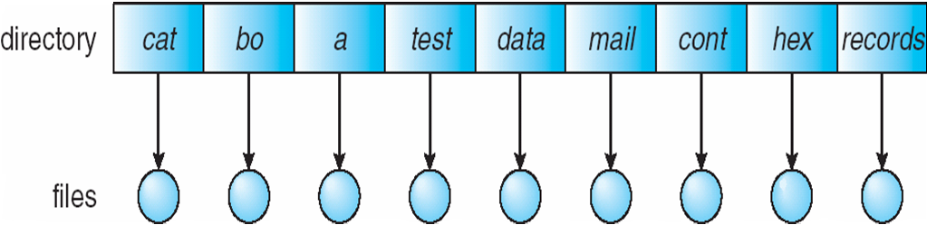
Single-Level Directory(单层结构目录)
单层目录，存放所有的用户的所有文件
Naming problem
Grouping problem

Slide 30
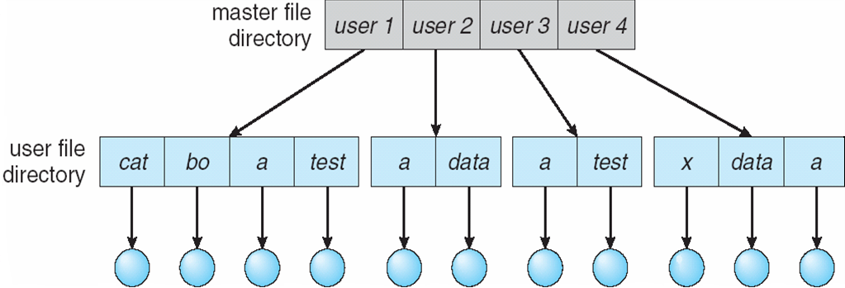
Two-Level Directory(双层结构目录)
每个用户一个目录
MFD 主文件目录
UFD 用户文件目录
Path name
Can have the same file name for different user
Efficient searching
No grouping capability

Slide 31
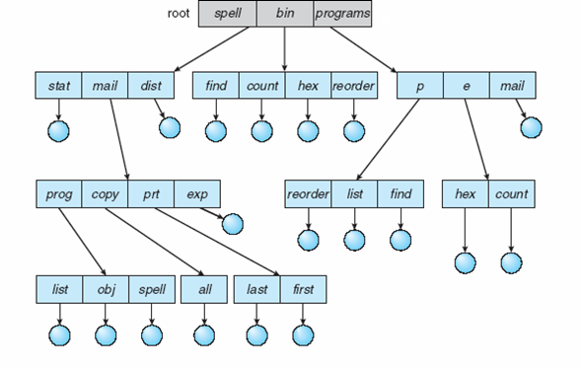
Tree-Structured Directories(树状结构目录)

Slide 32
Tree-Structured Directories (Cont.)
Efficient searching
Grouping Capability
Current directory (working directory)
cd /spell/mail/prog
type list(键入list，以启动程序list)

Slide 33
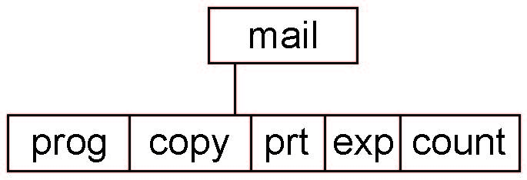
Tree-Structured Directories (Cont.)
Absolute or relative path name 绝对/相对路径名
Creating a new file is done in current directory
Delete a file
rm <file-name>
Creating a new subdirectory is done in current directory
mkdir <dir-name>
Example: if in current directory /mail
mkdir count
Deleting “mail” ⇒ deleting the entire subtree rooted by “mail”

Slide 34
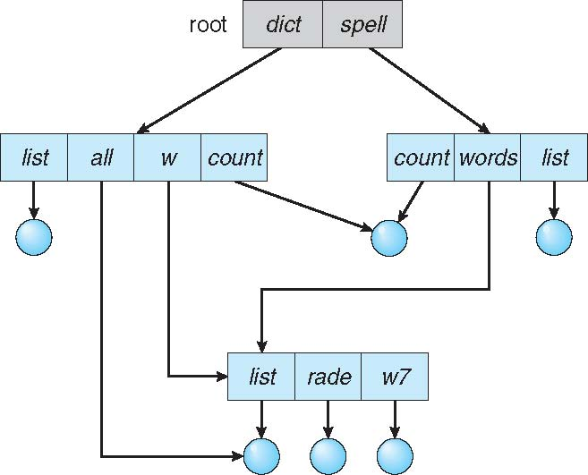
Acyclic-Graph Directories(无环图目录)
Have shared subdirectories and files

Slide 35
Acyclic-Graph Directories (Cont.)
Two different names (aliasing，别名) 同一文件或子目录出现在两个不同的目录中
If dict deletes count⇒ dangling pointer(悬空指针)
解决方法：
Backpointers(反向指针), so we can delete all pointers Variable size records a problem(可能需要多个反向指针，存在可变长度记录的问题)
Backpointers using a daisy chain organization 反向指针串组成链表
Entry-hold-count solution 引用计数，计数为0时，即可删除该文件
创建共享的文件/目录条目
Link(链接) –指向另一个文件/目录的指针
Resolve the link(解析链接) – 处理指针，找到真正的文件/目录

Slide 36
Consider a file system where a file can be deleted and its disk space reclaimed while links to that file still exist.
What problems may occur if a new file is created in the same storage area or with the same absolute path name?
How can these problems be avoided?

Slide 37
无环图目录悬空指针
Have shared subdirectories and files

Slide 38
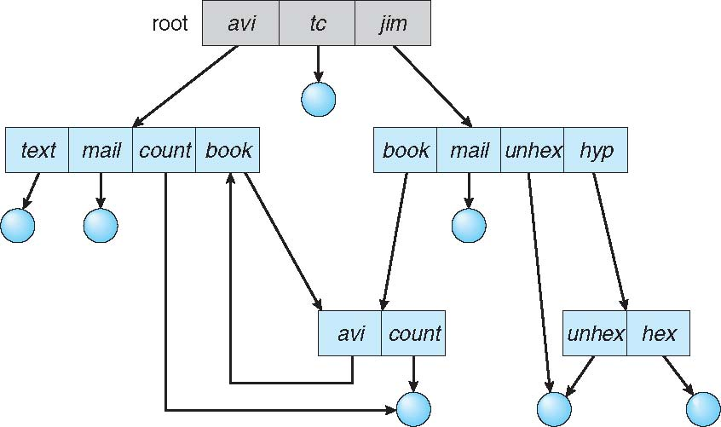
General Graph Directory(通用图目录)
如何避免遍历文件系统时多次搜索同一个子目录？

Slide 39
General Graph Directory (Cont.)
如何确保没有环？
仅允许链接到文件，但不允许链接到目录
Garbage collection(垃圾收集) 有可能自我引用
Every time a new link is added use a cycle detection algorithm to determine whether it is OK

Slide 40
10.4 File System Mounting(文件系统安装)
A file system must be mounted before it can be accessed
A unmounted file system (i.e., Fig. (b)) is mounted at a
mount point(安装点)

Slide 41
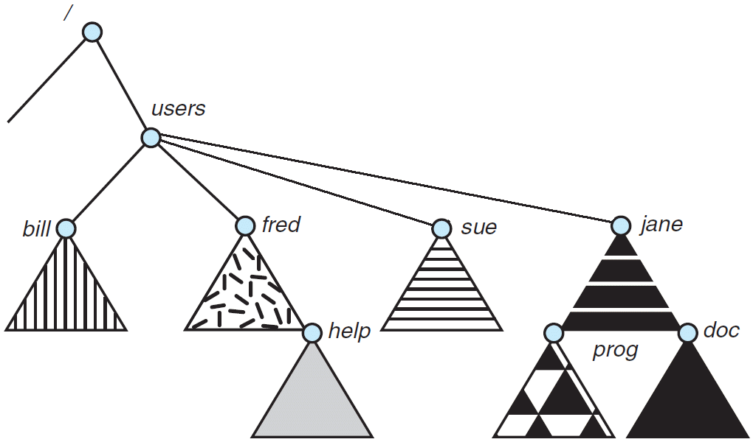
Mounted File System

Slide 42
10.5 File Sharing(文件共享)
Sharing of files on multi-user systems is desirable
Sharing may be done through a protection scheme
On distributed systems, files may be shared across a network
Network File System (NFS，网络文件系统) is a common distributed file-sharing method
If multi-user system
User IDs identify users, allowing permissions and protections to be per-user Group IDs allow users to be in groups, permitting group access rights
Owner of a file / directory
Group of a file / directory

Slide 43
File Sharing – Remote File Systems
Uses networking to allow file system access between systems
Manually via programs like FTP
Automatically, seamlessly using distributed file systems(分布式文件系统)
Semi automatically via the world wide web

Slide 44
File Sharing – Remote File Systems
Client-server(客户-服务器方式) model allows clients to mount remote file systems from servers
Server can serve multiple clients
Client and user-on-client identification is insecure or complicated
NFS(网络文件系统) is standard UNIX client-server file sharing protocol
CIFS(公共Internet文件系统) is standard Windows protocol
Standard operating system file calls are translated into remote calls

Slide 45
File Sharing – Remote File Systems
Distributed Information Systems (distributed naming services，分布式命名服务) such as LDAP(轻量级目录存取协议), DNS(域名系统), NIS(网络信息服务), Active Directory implement unified access to information needed for remote computing

Slide 46
File Sharing – Failure Modes(故障模式)
All file systems have failure modes
For example corruption of directory structures or other non-user data(非用户数据), called metadata(元数据)
Remote file systems add new failure modes, due to network failure, server failure
Recovery from failure can involve state information(状态信息) about status of each remote request
Stateless protocols(无状态协议) such as NFS v3 include all information in each request, allowing easy recovery but less security

Slide 47
File Sharing – Consistency Semantics(一致性语义)
描述多用户同时访问共享文件时的语义。特别是一个用户修改的数据，另一个用户何时可见
类似于第6章的进程同步算法
但由于磁盘及网络的延迟巨大，因此不适合复杂的算法
Andrew File System (AFS) 实现了复杂远程文件共享语义
Unix file system (UFS) implements:
向一个打开的文件写入，其他打开同一个文件的用户立即可见
有一种共享模式，允许用户共享当前文件指针的位置，这样允许多个用户协作读写文件
AFS 会话语义仅对文件关闭后，对其的修改能被以后打开的会话所见

Slide 48
10.6 Protection(保护)
File owner/creator should be able to control:
what can be done
by whom
Types of access
Read
Write
Execute
Append
Delete
List

Slide 49
Access Control Lists(访问控制列表)
为每个文件和目录增加一个访问控制列表，指定每个用户的访问类型
可以设定复杂的访问规则，精确控制每一个用户或用户组的访问权限
创建ACL比较繁琐
ACL长度不定，导致文件目录条目也是长度可变的，增加了存储管理的难度
许多系统采用了后页采用的定长的简化方式

Slide 50
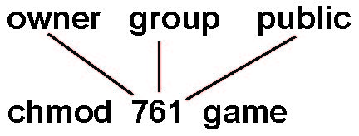
Access Lists and Groups(访问列表与分组)
Mode of access: read, write, execute
Three classes of users on Unix / Linux
RWX
a) owner access 7 ⇒ 1 1 1 RWX
b) group access 6 ⇒ 1 1 0
RWX
c) public access 1 ⇒ 0 0 1
Ask manager to create a group (unique name), say G, and add some users to the group.
For a particular file (say game) or subdirectory, define an appropriate access.
Attach a group to a file chgrp G game

Slide 51
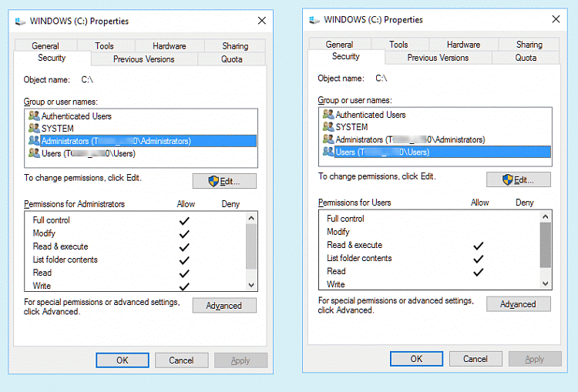
Windows 10 Access-Control List Management

Slide 52
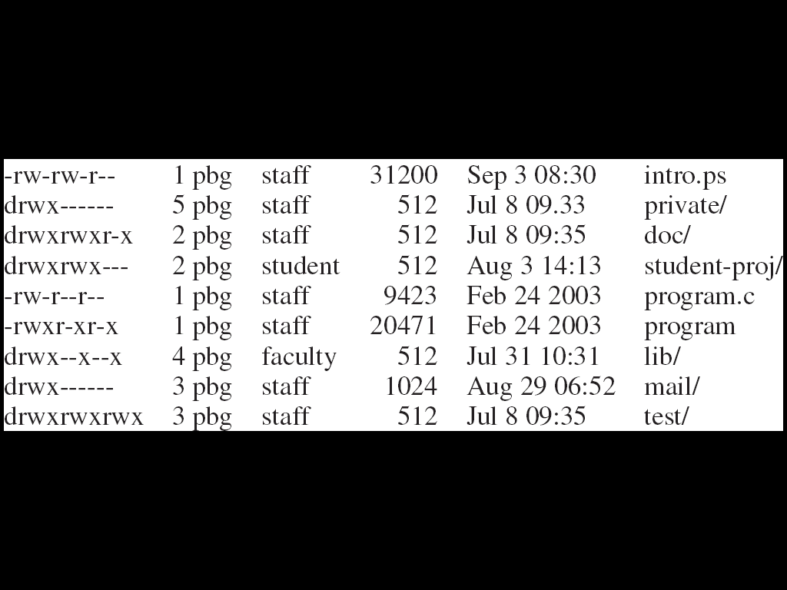
A Sample UNIX Directory Listing
The first field describes the protection of the file or directory. A d as the first character indicates a subdirectory. Also shown are the number of links to the file, the owner’s name, the group’s name, the size of the file in bytes, the date of last modification, and finally the file’s name (with optional extension)

Slide 53
Summary 1/3
A file is an abstract data type defined and implemented by the operating system. It is a sequence of logical records. A logical record may be a byte, a line (of fixed or variable length), or a more complex data item. The operating system may specifically support various record types or may leave that support to the application program.
A major task for the operating system is to map the logical file concept onto physical storage devices such as hard disk or NVM device. Since the physical record size of the device may not be the same as the logical record size, it may be necessary to order logical records into physical records. Again, this task may be supported by the operating system or left for the application program.

Slide 54
Summary 2/3
Within a file system, it is useful to create directories to allow files to be organized. A single-level directory in a multiuser system causes naming problems, since each file must have a unique name. A two-level directory solves this problem by creating a separate directory for each user’s files. The directory lists the files by name and includes the file’s location on the disk, length, type, owner, time of creation, time of last use, and so on.
The natural generalization of a two-level directory is a tree-structured directory. A tree-structured directory allows a user to create subdirectories to organize files. A cyclic-graph directory structures enable users to share subdirectories and files but complicate searching and deletion. A general graph structure allows complete flexibility in the sharing of files and directories but sometimes requires garbage collection to recover unused disk space.

Slide 55
Summary 3/3
Remote file systems present challenges in reliability, performance, and security. Distributed information systems maintain user, host, and access information so that clients and servers can share state information to manage use and access.
Since files are the main information-storage mechanism in most computer systems, file protection is needed on multiuser systems. Access to files can be controlled separately for each type of access—read, write, execute, append, delete, list directory, and so on. File protection can be provided by access lists, passwords, or other techniques.

Slide 56
End of Chapter 10: File-System Interface

